Slide 1

S7 PROJECT MID REVIEW
Cross-Layer Verification of an Untrusted IoT Gateway
Detecting a compromised smart-home hub with an independent radio witness
Guided by
Dr. Kurunandan Jain
Mentored by
Pavan Raja
Bhaskar S L · AM.SC.U4CYS23017
Arjun S · AM.SC.U4CYS23012

Slide 2
Outline
Introduction
Problem Definition
Literature Review Summary
Research Gap
Methodology
Design / Architecture
Algorithms
Result Analysis — real captures (ZIOTP2025), injected attacks, baselines, detection floor, live demo
Project Time Line (Plan)
References
Cross-Layer Verification of an Untrusted IoT Gateway

Slide 3
INTRODUCTION
Zigbee / Thread / Matter devices cannot reach the internet — every one of them speaks 802.15.4 to a gateway
The gateway is the only entity that sees both domains; app, automations, cloud and audit log accept what it reports
Real hubs get compromised (Hue Bridge CVE-2020-6007, SmartThings RCE chain, Home Assistant CVE-2023-27482)
This project treats the hub as an untrusted RF↔IP translator and checks its reporting against an independent radio witness
15 h
12
7
4
18
real 802.15.4 traffic parsed (ZIOTP2025)
real radio + IP capture pairs of one hub
gateway-misbehaviour classes injected
invariants + R-GCN residual, k-of-n
tests, 4 against dataset ground truth
Status at week 12
Verification engine implemented end to end (≈ 5 k lines) and validated on real captures
Attacks injected on the real traffic with exact ground truth; live dashboard replays real data
Simulator kept only for the RSSI form of forgery and the detection-floor sweep
Design doc v3 answers the guide's design questions; own testbed (nRF52840 + HA) is next
Cross-Layer Verification of an Untrusted IoT Gateway

Slide 4
Problem Definition
Motivation
Hue Bridge heap overflow over the air (~100 m); ~20 SmartThings flaws chained to RCE; HA auth bypass
Every case lands the attacker on the RF→IP translator — the single point of truth for the home
TLS, secure boot, NIDS, attestation protect channel, boot, flow shape or code — never the truth of the data
Matter / Thread border routers spread the privileged translator role across more vendors
Problem statement
There is no mechanism to verify whether an IoT gateway reports truthfully about the devices behind it
Adversary: a Byzantine gateway that can hide, invent, swap, change, delay or leak — and, owning a radio, forge
Trusted: a separate verification host with its own clock and radio; baseline learned while the hub is honest
Objectives
O1 Formal invariant set — conservation, provenance, translation, emitter consistency — honesty made testable
O2 Independent witness pipeline: loss accounting, learned bands, k-of-n persistence, attributed alerts
O3 First dataset with a gateway that lies — paired radio + IP, labelled per window
O4 Quantified detection floor as a function of capture completeness C and window T
O5 Transfer study: what is invariant vs. what is a fingerprint
Cross-Layer Verification of an Untrusted IoT Gateway

Slide 5
Literature Review Summary (1/2)
# | Paper · Venue · Year | Key contribution | Demerit / assumption | Dataset used | Evaluation metrics
1 | Marti, Giuli, Lai, Baker — Watchdog / Pathrater · MobiCom 2000 | Passive overhearing infers a next hop that failed to forward | Same radio, exact frame; evadable by power control; ambiguous collisions | ns-2 simulation (50-node MANET) | Throughput, overhead, false positives
2 | Karlof & Wagner — Secure routing in WSNs · SNPA / Ad Hoc Networks 2003 | Attack taxonomy: selective forwarding, sinkhole, Sybil, wormhole | Assumes cooperating in-network nodes; single radio domain | Protocol analysis, no dataset | Qualitative
3 | Przydatek, Song, Perrig — SIA · SenSys 2003 | Verify an untrusted aggregator by aggregate-commit-prove | Needs instrumented, cooperating sensor nodes | Analysis + simulation | Communication overhead, approximation bound
4 | Faria & Cheriton — Signalprints · WiSe 2006 | RSSI vectors at several sensors identify a transmitter; hard to forge | Multiple sensors; 802.11; mobility breaks prints | Own 802.11 testbed | Signalprint match rate, false accept / reject
5 | Akestoridis et al. — Zigator · WiSec 2020 | Metadata-only analysis of encrypted Zigbee; jamming / spoofing attacks | Characterises the radio only; never compared to hub reporting | Own captures (CRAWDAD cmu/zigbee-smarthome, ~35 h) | Attack demonstrations, packet classification
Cross-Layer Verification of an Untrusted IoT Gateway

Slide 6
Literature Review Summary (2/2)
# | Paper · Venue · Year | Key contribution | Demerit / assumption | Dataset used | Evaluation metrics
6 | Zhang et al. — HoMonit · CCS 2018 | Encrypted side-channel fingerprints vs. a DFA of expected app behaviour | Trusts the hub's app inventory and event stream | Own SmartThings testbed, 60 SmartApps | Precision / recall of misbehaviour detection
7 | Meng et al. — IoTGaze · INFOCOM 2020 | Wireless context vs. expected context from app descriptions | Trusts the declared app behaviour | Own SmartThings testbed | Precision, recall, F1
8 | Birnbach, Eberz, Martinovic — Peeves · CCS 2019 | Verifies physical events with an ensemble of ~48 sensors | Needs many extra sensors; verifies events, not the reporting path | Own instrumented office, 22 event types | Detection rate / false positives (EER)
9 | Fu, Zeng, Du — HAWatcher · USENIX Security 2021 | Semantics-aware correlations, shadow execution flags divergence | Trusts the event log the hub produces | 4 SmartThings testbeds, 62 apps | Precision / recall
10 | Boiano et al. — ZIOTP2025 · arXiv 2602.03140, 2026 | Public 802.15.4 corpus: 21 devices, 2 topologies, Home Assistant hub | Benign only — honest hub; no adversarial ground truth | ZIOTP2025 (252,896 frames) | Macro-F1: device type 0.95→0.74, device ID 0.89→0.41 across topologies
Rows 1–2: watchdog ancestry (same radio, exact) · rows 6–9: verify automation logic and trust the hub · rows 5, 10: radio data, our benign baseline
Cross-Layer Verification of an Untrusted IoT Gateway

Slide 7
Research Gap
Gaps in prior work
No work verifies the hub's own northbound reporting across the RF↔IP boundary — watchdogs stay inside one radio
The adversary is the translator itself — prior taxonomies place the attacker among the nodes, not at the bridge
Absence cannot be authenticated — no cryptographic construct proves a message was never sent; evidence must be out of band
No dataset contains a gateway that misreports — ZIOTP2025, ZigBeeNet, ZBDS2023, Zigator all record an honest hub
No stated detection floor — cross-layer binding is statistical, yet prior work reports accuracy, not the loss-dependent limit
Confirmed on real data (wk 12)
No public 802.15.4 corpus carries RSSI/LQI — the physical-layer form of emitter consistency is untestable on any of them
Real stacks' NWK counters skip values (coordinator every other; Philips two interleaved) — loss must be counted on MAC counters
Real homes are meshes: sensors reach the hub via routers, but the cleartext NWK header still names the originator
A real hub's app channel gives every device a ~40 B compressed push — length carries no identity, conservation must be a ratio
Cross-Layer Verification of an Untrusted IoT Gateway

Slide 8
Methodology
Element | What is used | Status / notes
Dataset (real) | ZIOTP2025 — 91 captures, 15.4 h, 252,896 802.15.4 frames, 21 devices, 2 topologies; 12 captures paired in time with tcpdumps of the Home Assistant hub (GitHub, Apache-2.0) | Primary. Parsed to the frame; ground-truth device labels verified
Dataset (adversarial) | Trace-driven injection of misbehaviour on the real pairs (hide, invent, swap, change, delay, leak, forge) with exact per-event labels | This project's corpus; simulator kept for the RSSI form of forgery and the detection-floor sweep
Hardware | Dataset: Raspberry Pi 4 + Home Assistant OS + Sonoff EFR32MG21 coordinator, CC2531/whsniff sniffer. Ours (next): Pi 4/5 verification host + nRF52840 witness + IP tap | Own testbed weeks 13–15
Platform | Python 3.10+ (Windows / Linux), Docker image for the Pi; no PyTorch needed on the host | v0.5, 18 pytest tests
Capture | pcap/pcapng readers: nRF TAP (DLT 283), CC2531 (DLT 195, FCS/CC24xx auto-detected), cleartext NWK header; hub-flow IP reader with TLS record segmentation and SNI; tshark CSV | scapy for pcapng only
Processing | MAC-seq loss accounting + orphan-ACK cross-check → completeness C; T = 5 s windows on one clock, 60–120 s rolling horizon; commissioning signatures; ML record attribution | NumPy / pandas
Detection | Four invariants with learned bands (quantile 0.995, floors from measured loss), R-GCN translation residual, 3-of-5 persistence, attribution, alert schema | Rules validated on real data; residual calibrated on simulator
Sinks | SQLite record of truth, JSON lines for SIEM, MQTT topic for Home Assistant, capped evidence directory, local dashboard | Nothing sent to the vendor cloud
Evaluation | 3-fold cross-validation on real pairs; per-window TPR/FPR, episode detection, latency, false alerts/day, attribution; baselines (a)–(d); detection floor f × C × T; cross-topology transfer | scripts/ziotp_experiments.py, run_ablations.py, run_detection_floor.py
Cross-Layer Verification of an Untrusted IoT Gateway

Slide 9
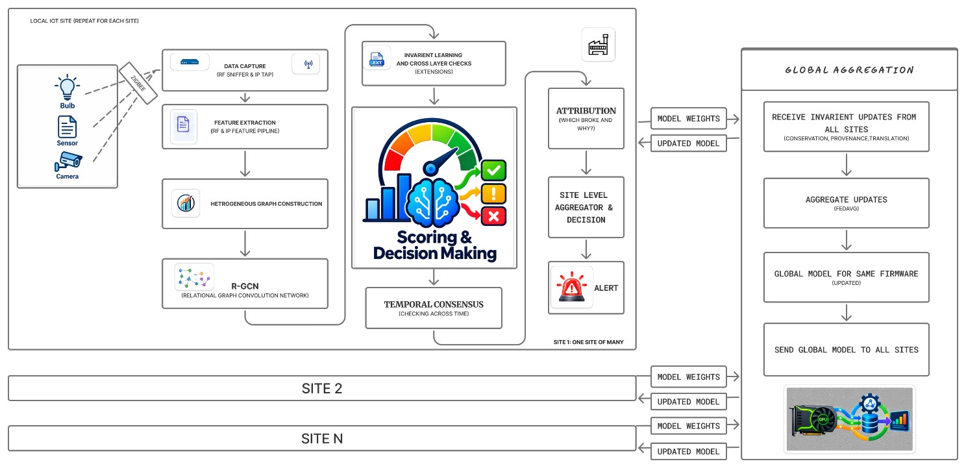
Design / Architecture
As implemented (v0.5)
1. Dual capture: RF sniffer + IP tap
2. Loss accounting → completeness C
3. 5 s windows, rolling horizon
4. Signatures + record attribution
5. Four invariants + R-GCN residual
6. Temporal consensus: 3-of-5
7. Attribution → 7.1 alert sinks
Metadata only — never decrypts
Global aggregation: later phase
Novelty — a new trust boundary: the hub is a Byzantine RF→IP translator, verified by a witness it cannot feed or route around
Novelty — a testable invariant set that survives an adversary who also transmits (RSSI form, link-layer fallback)
Novelty — the first paired radio + IP corpus with a lying gateway, and a quantified detection floor instead of a completeness claim
Cross-Layer Verification of an Untrusted IoT Gateway

Slide 10
Algorithms 1 — invariants and decision
Invariant | Statistic per device d over the rolling horizon | Learned band | Violation ⇒ interpretation
Conservation | deficit = received − reports; report_ratio = reports / received (received = frames the hub provably ACKed + orphan ACKs) | quantile 0.995 of benign windows × 1.25 margin, floor 1 count; ratio band lowered by 0.15; deficit counts only if the ratio is also low | ratio low / deficit ⇒ suppression; surplus ⇒ fabrication; egress to a never-seen endpoint ⇒ exfiltration
Provenance | unprovenanced = hub records credited to d with no radio from d within Δt (Δt = 1 s on the real hub; its pushes are batched) | as above; a record is credited by max-likelihood over length z-score + delay z-score, else to the signature class | misattribution (event of A reported as B) or fabrication
Translation | len_z, delay_z: mean |z| of record length / delay vs d's signature; out-of-band fractions (|z| > 2.5) | z floor 3.0; fraction floor 0.5; ≥ 2 records in horizon to be evaluable | tampered translation (length or timing drift with no firmware change)
Emitter consistency | RSSI form: |z| of RSSI/LQI vs d's signature, out-of-band fraction. Link-layer form (no RSSI): MAC counter discontinuities under d's address; duplicate ACKs | per-device band (3σ) from commissioning variance; discontinuity band absorbs loss bursts > 24 frames | frames not emitted by d — the hub (or another radio) forged the evidence
Fail-safe | completeness C < 0.70 over the horizon, or retransmission rate > 40 % | — | window reported as degraded — cannot verify (never 'all clear'); jamming becomes an alert, not a blind spot
Persistence | k-of-n: a (device, invariant) finding is confirmed when ≥ 3 of the last 5 evaluable windows agree; clears when evidence is absent | k = 3, n = 5, T = 5 s, horizon 60 s (real) / 120 s (simulated) | one confirmed alert per finding: device or class, window, invariant, direction, observed, band, completeness, evidence path
Cross-Layer Verification of an Untrusted IoT Gateway

Slide 11
Algorithms 2 — learning, training, testing
Commissioning (training) — benign window only
Hyperparameter | Value
Window T / horizon | 5 s / 60 s (real), 120 s (sim)
Provenance Δt | 1.0 s (real hub), 1.0 s (sim)
Persistence k of n | 3 of 5 evaluable windows
Degraded thresholds | C < 0.70; retx rate > 40 %
Band quantile / margin | 0.995 / ×1.25; z floor 3.0
Signature min events | 4 (real, short captures) / 8 (sim)
R-GCN | 2 layers, hidden 32, 4 relations
Optimiser | Adam, lr 5e-3, wd 1e-4, batch 256
Epochs / early stop | ≤ 300, patience 40, 25 % val
Residual threshold | q 0.999 × 2.0, floor 4.0
CV folds / seeds | 3 folds × 2 seeds per attack
Parse both captures → frames (MAC + NWK header) and hub records (TLS)
Loss accounting → retx / lost / ACKed flags, orphan ACKs, completeness C
Per-device signatures: endpoint, length, delay, RSSI/LQI (median / MAD)
Window features + rolling horizon → benign quantile bands, widened by loss
R-GCN residual: radio-side inputs → IP-side counts; threshold q 0.999 × 2
Verification (testing)
Held-out captures → same pipeline → invariants + residual → k-of-n → alerts
ZIOTP: 3-fold CV per topology — 4 pairs commission, 2 pairs verify
Attacks injected on the verify pairs with per-event ground truth
Metrics: window TPR/FPR, episode detection, latency, false alerts/day
Cross-Layer Verification of an Untrusted IoT Gateway

Slide 12
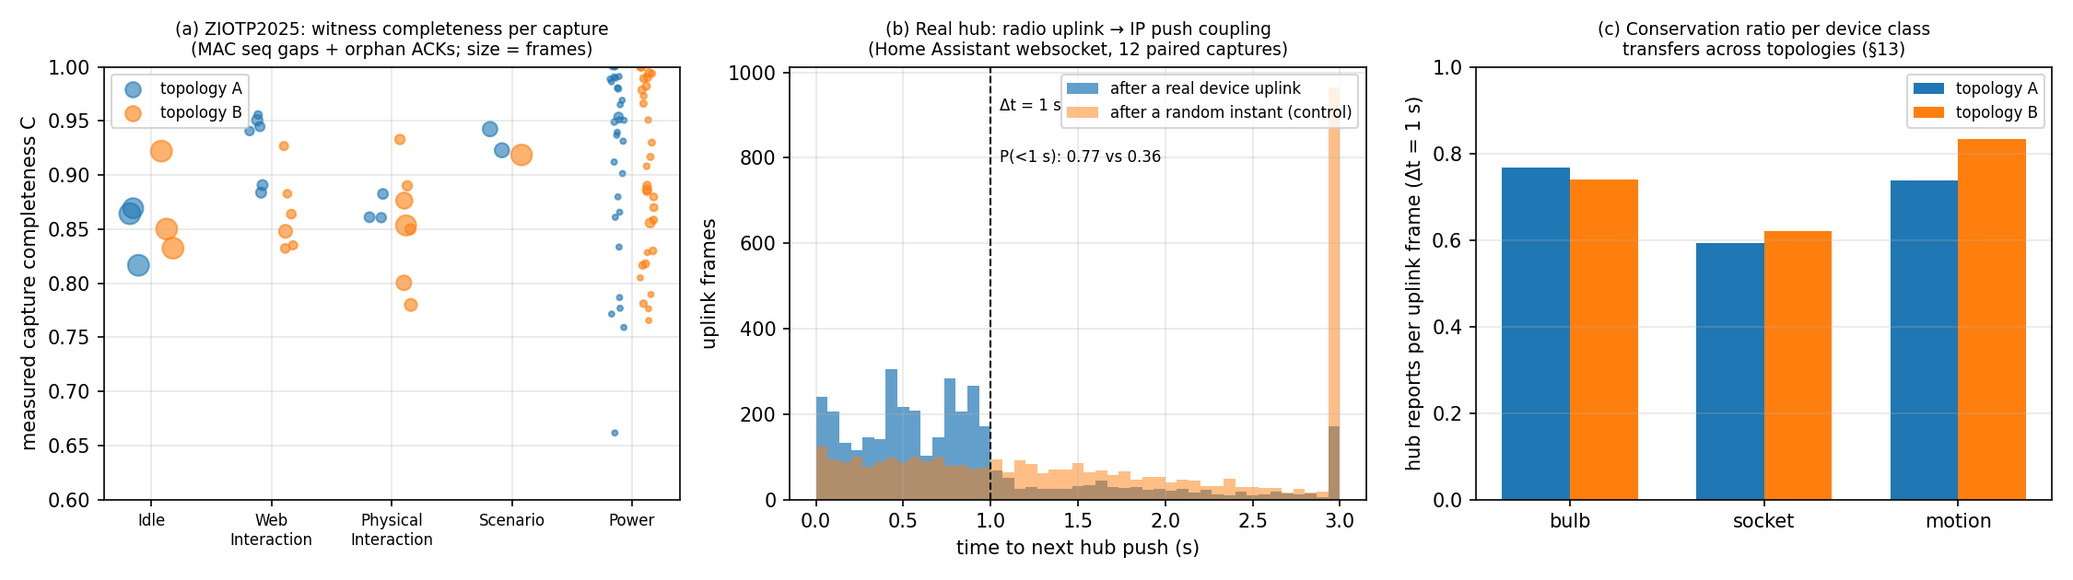
Result Analysis 1 — the real captures
15.4 h
252,896
0.89 / 0.88
96% / 98%
12
of real 802.15.4 traffic, 91 captures, 21 commercial devices, 2 topologies
frames parsed — matches the dataset paper's count exactly
measured witness completeness C, topology A / B (MAC seq gaps + orphan ACKs)
of device uplinks confirmed by a captured coordinator ACK
real radio+IP capture pairs of the same hub (Home Assistant on a Pi 4)
(a) Loss sits where 10 predicts — the co-located coordinator loses < 2 %; the routers farthest from the sniffer lose most
(b) A device uplink is followed by a hub push within 1 s in 77 % of cases vs 36 % at a random instant — real radio→IP coupling
(c) Per-class conservation ratio transfers across topologies within ≈ 10 %; 3,544 orphan ACKs recovered, CRC failures 4.3%
Cross-Layer Verification of an Untrusted IoT Gateway

Slide 13
Result Analysis 2 — attacks on real traffic
Attack (2.1) | Episodes detected | Topology A | Topology B | Median latency | Attribution | Episodes
Leak (exfiltration) | 1.00 | 1.00 | 1.00 | 10 s | 0.71 | 17
Change (tamper) | 0.72 | 1.00 | 0.44 | 42 s | 0.69 | 34
Forge (spoofed frames) | 0.56 | 0.61 | 0.50 | 26 s | 0.62 | 26
Delay | 0.50 | 0.67 | 0.33 | 50 s | 0.49 | 26
Swap (misattribution) | 0.50 | 0.67 | 0.33 | 50 s | 0.49 | 32
Invent (fabrication) | 0.46 | 0.58 | 0.33 | 72 s | 0.43 | 16
Hide (suppression) | 0.43 | 0.58 | 0.28 | 50 s | 0.47 | 35
1.00 in 10 s
exfiltration episodes caught, both topologies
0.56
spoofed-frame episodes caught with no RSSI
21 / 43 min
benign alerts on held-out real traffic
Exfiltration is caught every time within 10 s — egress to a host never seen at commissioning is unambiguous
Spoofed frames are caught without RSSI via the link-layer form (counter discontinuity, duplicate ACKs) — no added benign alerts
Hide / delay / swap / invent land near half — episodes are 1–3 min and the 60 s horizon + 3-of-5 persistence cost 40–70 s
Benign: 21 alerts in 43 min, traced to 13–16 min commissioning windows; 14 % of windows reported degraded
Lower bounds: ZIOTP's IP side is an app's batched websocket, not the MQTT / cloud telemetry path the design targets
Cross-Layer Verification of an Untrusted IoT Gateway

Slide 14
Result Analysis 3 — baselines and SOTA
Episode detection (simulated testbed, C = 0.95) | hide | invent | swap | change | delay | leak | forge | mixed | False alerts / day (benign)
Ours: rules | 1.00 | 1.00 | 1.00 | 1.00 | 1.00 | 1.00 | 0.89 | 1.00 | 12
Ours: rules + R-GCN | 1.00 | 1.00 | 1.00 | 1.00 | 1.00 | 1.00 | 0.89 | 1.00 | 49
(a) IP-only NIDS (IsolationForest, flow-based) | 0.00 | 0.00 | 0.00 | 0.00 | 0.00 | 0.00 | 0.00 | 0.14 | 12
(c) radio witness ablated | 0.00 | 0.00 | 0.00 | 1.00 | 0.00 | 1.00 | 0.00 | 0.43 | 0
(d) RSSI/LQI ablated | 1.00 | 1.00 | 1.00 | 1.00 | 1.00 | 1.00 | 0.11 | 0.86 | 24
IP-only NIDS — the standard position — sees nothing: a compromised hub's egress is well-formed
Without the radio witness only the IP-visible attacks remain (exfiltration, a length-changing tamper)
Without RSSI/LQI forgery drops 0.89 → 0.11 and nothing else changes — the physical layer isolates the forging adversary
R-GCN residual: same detection, hide latency 58 → 35 s, but benign alerts 12 → 49 / day — secondary until calibrated on real data
Cross-topology transfer vs. the published SOTA ( real data)
Conservation ratio holds within ≈ 10 % across topologies
Relay structure differs completely between A and B
The paper's fingerprints collapse on the same data
A behavioural invariant survives what breaks a fingerprint
Device class | A: reports / uplink | B: reports / uplink | Published fingerprint (ZIOTP paper)
bulb | 0.77 | 0.74 | device type F1 0.95 → 0.74 across topologies
socket | 0.59 | 0.62 | device ID F1 0.89 → 0.41 across topologies
motion | 0.74 | 0.83 | battery devices worst affected
Cross-Layer Verification of an Untrusted IoT Gateway

Slide 15
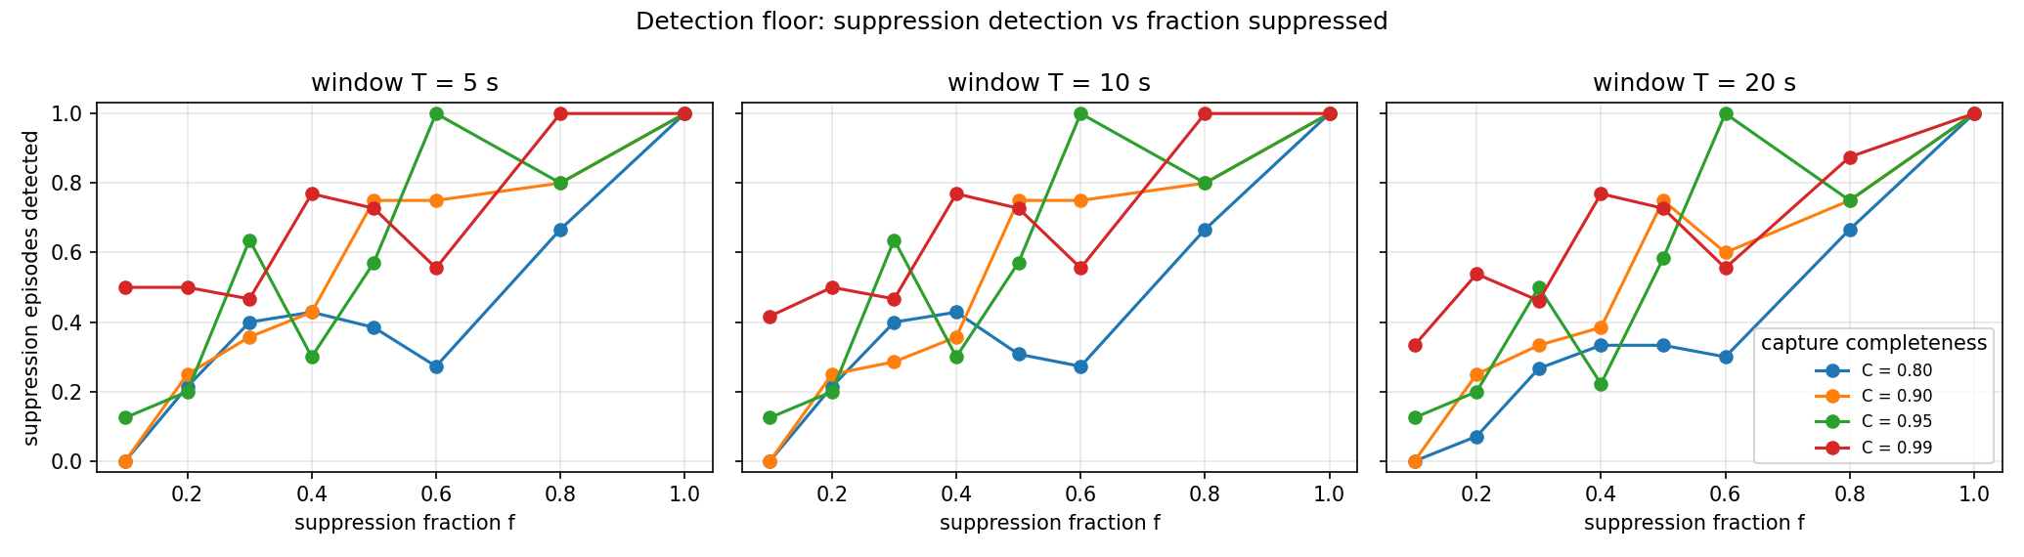
Result Analysis 4 — detection floor
C \ f | 0.1 | 0.2 | 0.3 | 0.5 | 0.8 | 1.0
0.99 | 0.50 | 0.50 | 0.47 | 0.73 | 1.00 | 1.00
0.95 | 0.12 | 0.20 | 0.64 | 0.57 | 0.80 | 1.00
0.90 | 0.00 | 0.25 | 0.36 | 0.75 | 0.80 | 1.00
0.80 | 0.00 | 0.21 | 0.40 | 0.38 | 0.67 | 1.00
Detection rises with f and with C: at C = 0.99 half of the f = 0.1 episodes are caught
At C = 0.80 suppression below f ≈ 0.6 is largely invisible; loss widens the tolerance band
T barely matters once the evidence horizon is fixed — only latency grows with T
Stays on the simulator: a floor needs hours at controlled C and f; 43 min of real pairs cannot
Real anchor: measured C = 0.85–0.96 on ZIOTP puts the real operating point on the middle curves
This is the design's promise — a floor as a function of C and T, not a completeness claim
Suppression episodes detected vs. fraction suppressed f, T = 5 s (simulated)
Cross-Layer Verification of an Untrusted IoT Gateway

Slide 16
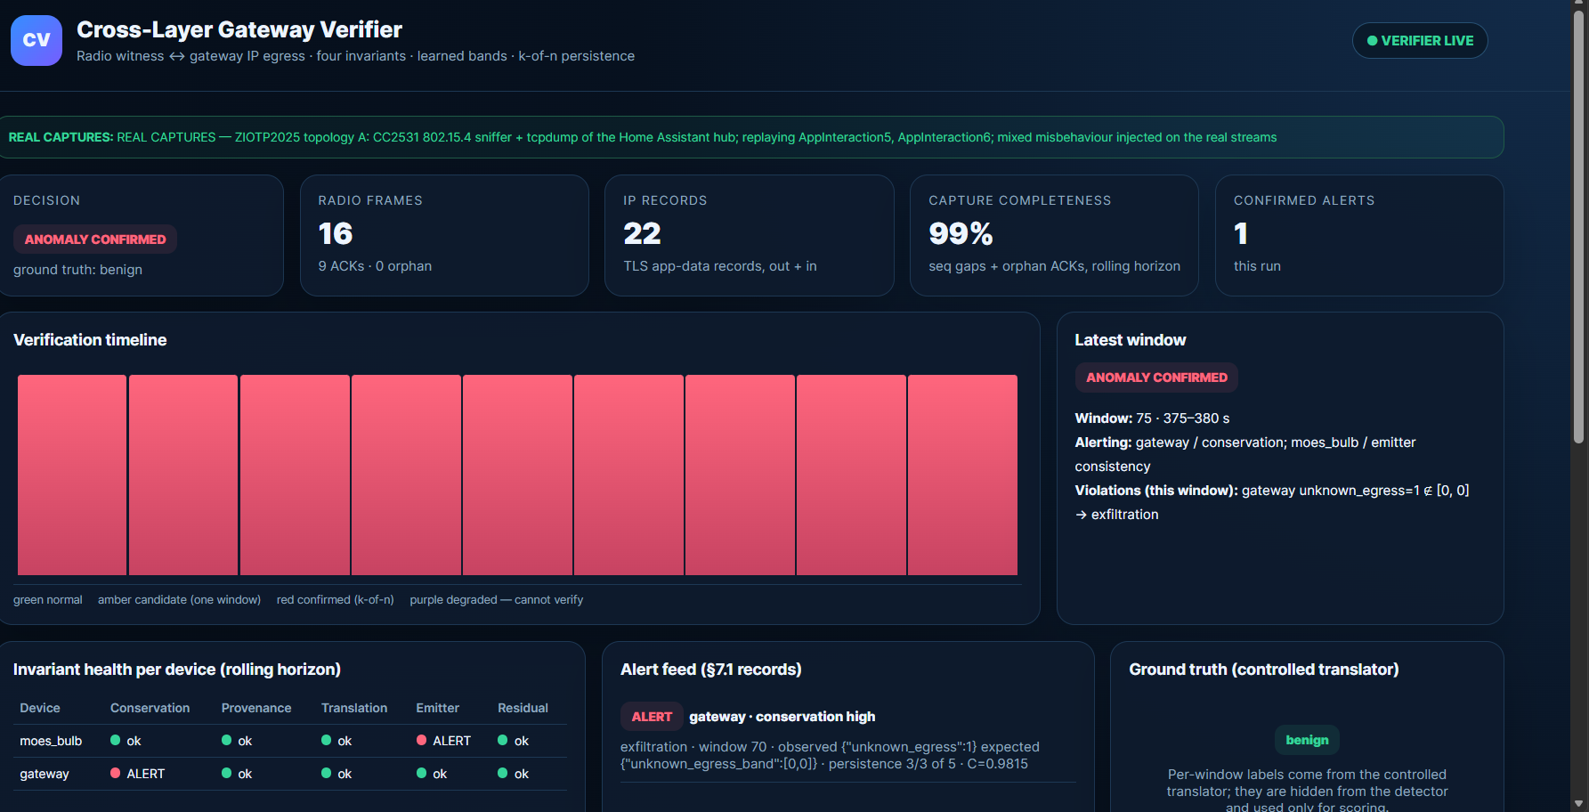
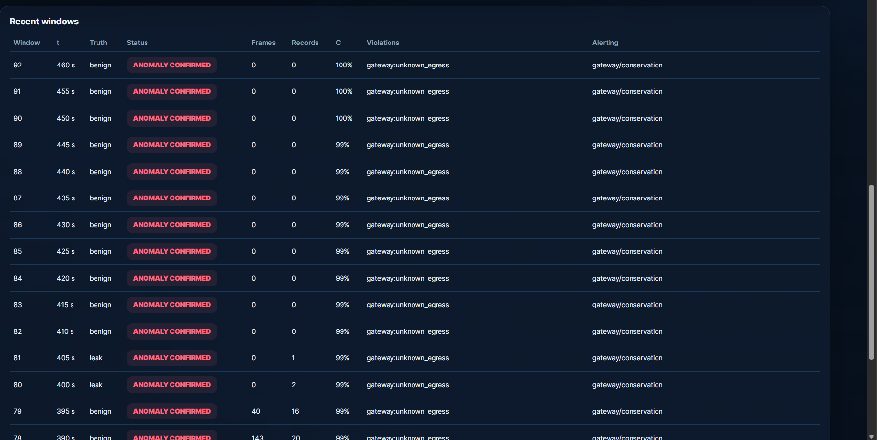
Result Analysis 5 — live dashboard, real data
Recent windows: injected leak confirmed as gateway / conservation
Both sides real: CC2531 radio + hub tcpdump (ZIOTP A)
Green banner names the captures being replayed
Cards: decision, frames, records, completeness C, alerts
Per-device invariant health over the rolling horizon
alerts: observed vs learned band, persistence 3 of 5
Injected mixed: hide → invent → forge → leak
Purple = degraded, cannot verify (real sniffer loss)
python real_main.py --root ZIOTP2025 --topology A --scenario mixed → http://127.0.0.1:8000/
Same engine and dashboard as the simulator
Banner switches: REAL CAPTURES (green) vs SIMULATED TESTBED (amber)
The audience never has to take the data source on trust
Cross-Layer Verification of an Untrusted IoT Gateway

Slide 17
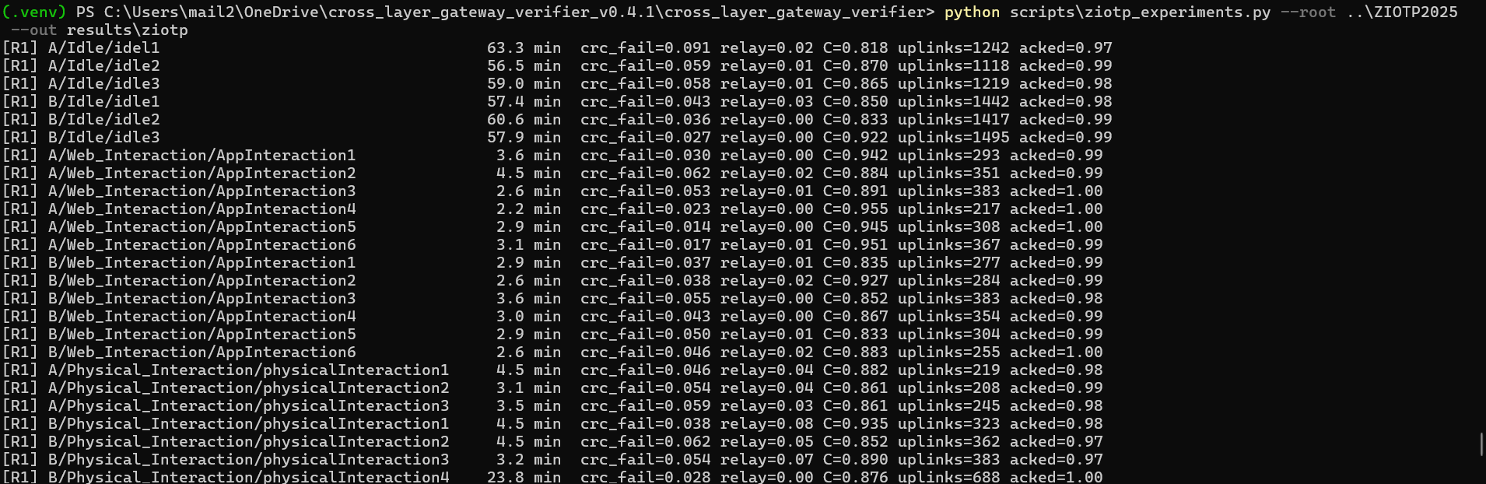
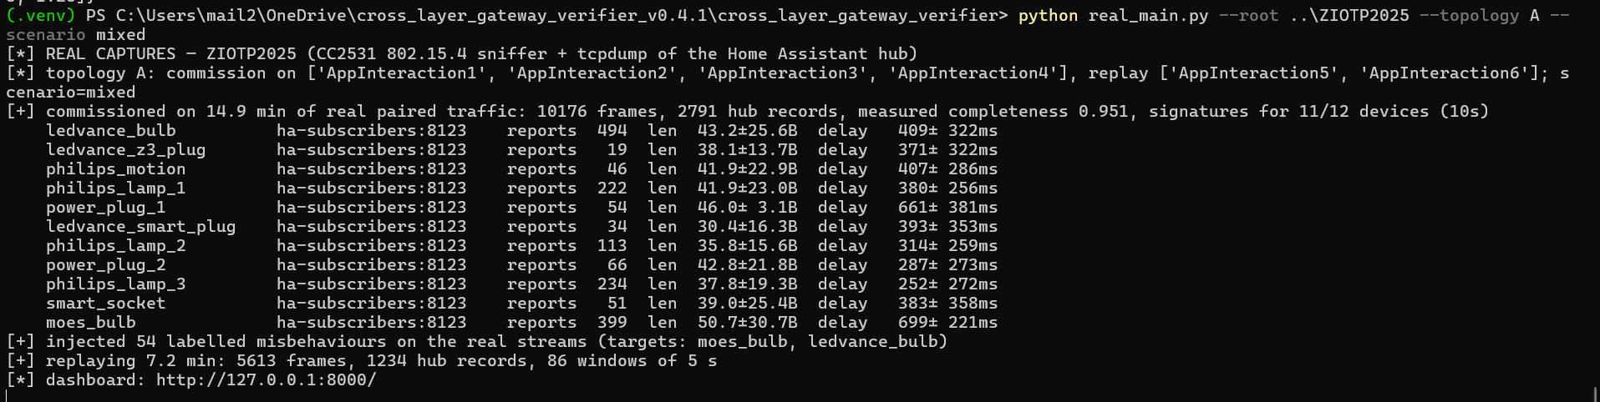
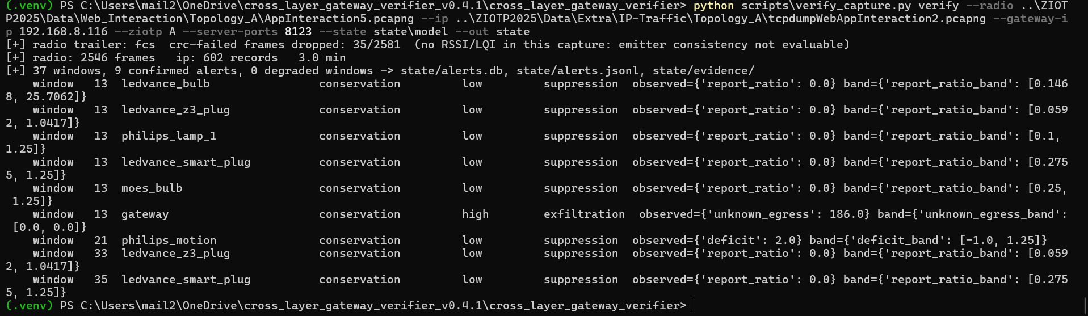
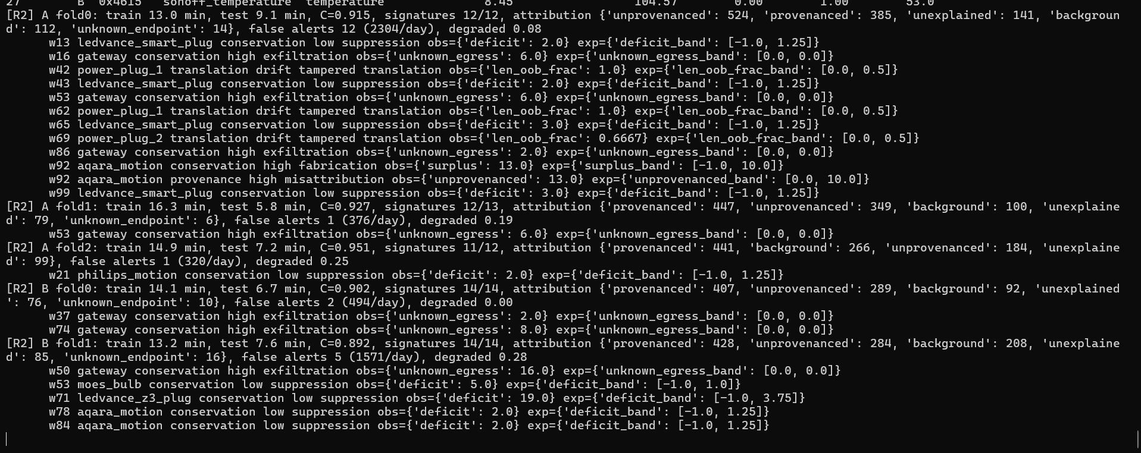
Result Analysis 6 — pipeline runs (terminal)
real_main.py: 14.9 min of real pairs commissioned in 10 s; every push ≈ 40 ± 20 B
R1: 91 captures parsed — CRC fails, relay fraction, completeness C, ACKed uplinks
verify_capture.py on a pcap pair: trailer detected, 37 windows, alerts with bands
Reproduce: python scripts/ziotp_experiments.py --root ../ZIOTP2025 (≈ 4 min)
python -m pytest tests → 18 pass, 4 of them against the dataset's ground truth
R2: 3-fold commissioning — signatures, attribution counts, alerts vs learned bands
Cross-Layer Verification of an Untrusted IoT Gateway

Slide 18
Project Time Line (Plan)
W1
W2
W3
W4
W5
W6
W7
W8
W9
W10
W11
W12
W13
W14
W15
W16
◄ completed (weeks 1–12)
planned (weeks 13–16) ►
W11–12
Real data: ZIOTP2025 parsers, mesh-aware loss accounting, attack injection, transfer study, dashboard, mid review
W13–14
Own testbed: nRF52840 witness + Home Assistant + IP tap on the MQTT / cloud path; hours of commissioning; RSSI form
W15–16
Controlled lying translator on the real hub → adversarial paired corpus; real detection floor; final report + paper
Current status: engine complete, validated on real captures · Next: the testbed — no public dataset has a hub that actually lies
Cross-Layer Verification of an Untrusted IoT Gateway

Slide 19
References
[1] S. Marti, T. Giuli, K. Lai, M. Baker, “Mitigating routing misbehavior in mobile ad hoc networks,” ACM MobiCom, 2000.
[2] C. Karlof, D. Wagner, “Secure routing in wireless sensor networks: attacks and countermeasures,” Ad Hoc Networks 1(2–3), 2003.
[3] B. Przydatek, D. Song, A. Perrig, “SIA: Secure information aggregation in sensor networks,” ACM SenSys, 2003.
[4] D. Faria, D. Cheriton, “Detecting identity-based attacks in wireless networks using signalprints,” ACM WiSe, 2006.
[5] D.-G. Akestoridis, M. Harishankar, M. Weber, P. Tague, “Zigator: Analyzing the security of Zigbee-enabled smart homes,” ACM WiSec, 2020.
[6] W. Zhang et al., “HoMonit: Monitoring smart home apps from encrypted traffic,” ACM CCS, 2018.
[7] Y. Meng et al., “IoTGaze: IoT security enforcement via wireless context analysis,” IEEE INFOCOM, 2020.
[8] S. Birnbach, S. Eberz, I. Martinovic, “Peeves: Physical event verification in smart homes,” ACM CCS, 2019.
[9] C. Fu, Q. Zeng, X. Du, “HAWatcher: Semantics-aware anomaly detection for appified smart homes,” USENIX Security, 2021.
[10] A. Boiano et al., “Analyzing Zigbee traffic: datasets, classification and storage trade-offs,” arXiv:2602.03140, 2026 (ZIOTP2025).
[11] N. Keleşoğlu, Ł. Sobczak, “ZigBeeNet: Decrypted Zigbee IoT network traffic dataset in smart home environment,” Appl. Sci. 14(23), 2024.
[12] Check Point Research, CVE-2020-6007 (Philips Hue Bridge), 2020; Cisco Talos, Samsung SmartThings Hub vulnerabilities, 2018.
[13] E. Ronen, A. Shamir, A.-O. Weingarten, C. O'Flynn, “IoT goes nuclear: Creating a ZigBee chain reaction,” IEEE S&P, 2017.
[14] CVE-2023-27482, Home Assistant Supervisor authentication bypass, 2023.
[15] M. Schlichtkrull et al., “Modeling relational data with graph convolutional networks,” ESWC, 2018 (R-GCN).
Cross-Layer Verification of an Untrusted IoT Gateway

